Slide 1
Unit-3
Pushdown automata
Turing Machine

Slide 2
Contents
Pushdown automata: Definition, model, acceptance of CFL, introduction to Deterministic PDA and Non-Deterministic PDA, design of PDA.
Turing Machine: Turing Machine, definition, model, design of TM, recursively enumerable languages.

Slide 3
Pushdown automata: Definition
Pushdown automata is a way to implement a CFG in the same way we design DFA for a regular grammar.
A DFA can remember a finite amount of information, but a PDA can remember an infinite amount of information.
A pushdown automaton (PDA) is a computational model that recognizes context-free languages.
It consists of an input tape, a stack, and a finite set of states.
A pushdown automaton (PDA) is a finite automaton equipped with a stack-based memory.
Each transition
is based on the current input symbol and the top of the stack,
optionally pops the top of the stack, and
optionally pushes new symbols onto the stack.
Initially, the stack holds a special symbol Z0 that indicates the bottom of the stack.

Slide 4
Instantaneous Description (ID)
Instantaneous Description (ID) is an informal notation of how a PDA “computes” an input string and makes a decision whether that string is accepted or rejected.
An ID is a triple (q, w, α), where: 1. q is the current state. 2. w is the remaining input. 3.α is the stack contents, top at the left.
Turnstile Notation
⊢ sign is called a “turnstile notation” and represents one move. ⊢* sign represents a sequence of moves. Eg- (p, b, T) ⊢ (q, w, α) This implies that while taking a transition from state p to state q, the input symbol ‘b’ is consumed, and the top of the stack ‘T’ is replaced by a new string ‘α’

Slide 5
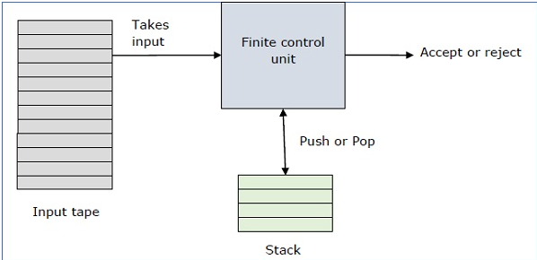
Model
A PDA may or may not read an input symbol, but it has to read the top of the stack in every transition.
PDA Components:
1.Input tape: The input tape is divided in many cells or symbols. The input head is read-only and may only move from left to right, one symbol at a time.
2.Finite control: The finite control has some pointer which points the current symbol which is to be read.
3. Stack: The stack is a structure in which we can push and remove the items from one end only. It has an infinite size. In PDA, the stack is used to store the items temporarily.

Slide 6
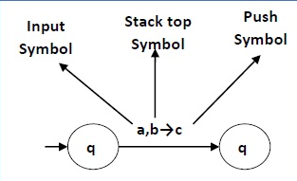
Pushdown automata: Definition
A PDA can be formally described as a 7-tuple (Q, ∑, Γ,δ, q₀, Z0,F) −
Q is the finite number of states
∑ is input alphabet
Γ is stack symbols
δ is the transition function: Q × (∑ ∪ {ε}) × Γ→ Q × Γ*
q₀ is the initial state (q₀ ∈ Q)
Z0 is the initial stack top symbol (Γ ∈ S)
F is a set of accepting states (F ∈ Q)
The following diagram shows a transition in a PDA from a state q₁ to state q₂, labeled as a,b → c −
This means at state q₁, if we encounter an input string ‘a’ and top symbol of the stack is ‘b’, then we pop ‘b’, push ‘c’ on top of the stack and move to state q₂.

Slide 7
Acceptance of CFL
There are two different ways to define PDA acceptability.
Final State Acceptability
In final state acceptability, a PDA accepts a string when, after reading the entire string, the PDA is in a final state. From the starting state, we can make moves that end up in a final state with any stack values. The stack values are irrelevant as long as we end up in a final state.
For a PDA (Q, ∑, Γ, δ, q₀, Z0, F), the language accepted by the set of final states F is −
L(PDA) = {w | (q₀, w, Z0) ⊢* (q, ε, x), q ∈ F} for any input stack string x.
Empty Stack Acceptability
Here a PDA accepts a string when, after reading the entire string, the PDA has emptied its stack.
For a PDA (Q, ∑, S, δ, q₀, Z0, F), the language accepted by the empty stack is −
L(PDA) = {w | (q₀, w, I) ⊢* (q, ε, ε), q ∈ Q}

Slide 8
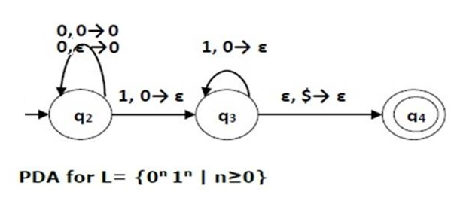
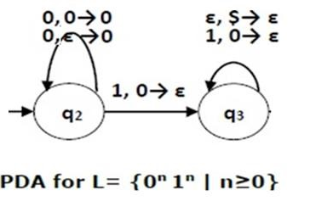
Example
Construct a PDA that accepts L = {0^{n} 1^{n} | n ≥ 0}
Solution
Final State Acceptability:
Empty Stack Acceptability:
This language accepts L = {ε, 01, 0011, 000111, ............................. } Here, in this example, the number of ‘a’ and ‘b’ have to be same.

Slide 9
Initially we put a special symbol ‘$’ into the empty stack.
Then at state q₂, if we encounter input 0 and top is Null, we push 0 into stack. This may iterate. And if we encounter input 1 and top is 0, we pop this 0.
Then at state q₃, if we encounter input 1 and top is 0, we pop this 0. This may also iterate. And if we encounter input 1 and top is 0, we pop the top element.
If the special symbol ‘$’ is encountered at top of the stack, it is popped out and it finally goes to the accepting state q₄.

Slide 10
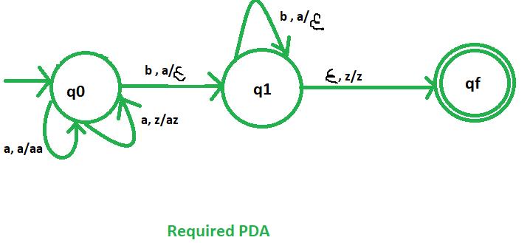
Example
Define the pushdown automata for language {a^{n}b^{n} | n>=1} Solution : M = where Q = {q0, q1, q2 } and Σ = { a, b } and Γ = {a ,Z0 } and δ is given by :
δ(q0, a, Z0 ) = { (q0, a Z0 ) } δ(q0, a, a) = { (q0, aa ) } δ(q0, a,a) = { (q0, aaa) } δ(q0, b, a) = { (q1, ∈) } δ(q1, b,a) = { (q1, ∈) }
δ(q1, b,a) = { (q1, ∈) }
δ(q1,∈, Z0) = { (q2, ∈) }

Slide 11
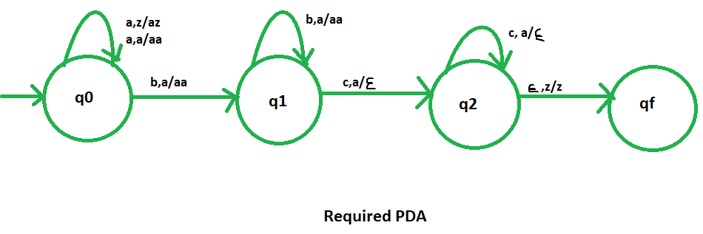
Example
Define the pushdown automata for language {a^{n}b^{m}C^{n} | n>=1, m>=1}
M = where Q = {q0, q1, q2, q3 } and Σ = { a, b,c } and Γ = {a ,Z0 } and δ is given by :
δ(q0, a, Z0 ) = { (q0, a Z0 ) } δ(q0, a, a) = { (q0, aa ) } δ(q0, b, a) = { (q1, aa) } δ(q1, c,a) = { (q2, ∈) }
δ(q2, c,a) = { (q2, ∈) }
δ(q2,∈, Z0) = { (q3, ∈) }

Slide 12
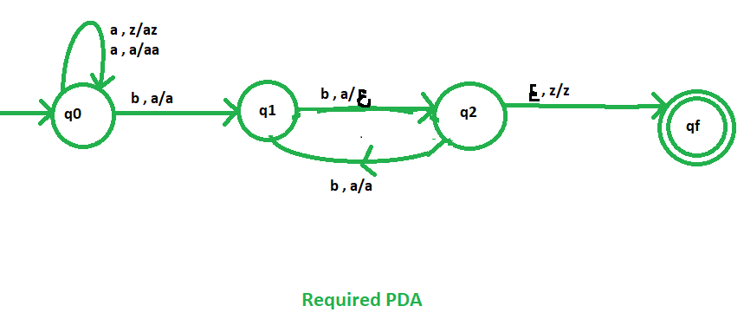
Example
Define the pushdown automata for language {a^{n}b^{2n} | n>=1}
Solution : L={abb,aabbbb,aaabbbbbb,..........}
Input string is aabbbb∈
Logic 1: step1: if we read ‘a’ then push two ‘a’s on stack
Step2: if we read ‘b’ then perform pop operation
For first ‘b’ operation change the state
For next pop operation there no need to change state
Step3: Repeat step2 until the entire input string completely processed.
Logic 2: step1: if we read ‘a’ then push ‘a’ on stack
Step2: Where as here two ‘b’s for first ‘b’ don’t perform any pop operation.
Where as second ‘b’ perform pop operation
For third ’b’ don’t perform pop operation
For fourth ‘b’ perform pop operation.
Step3: Repeat step2 until the entire input string completely processed.
M = where Q = {q0, q1, q2, q3 } and Σ = { a, b } and Γ = {a ,Z0 } and δ is given by :
δ(q0, a, Z0 ) = { (q0, a Z0 ) } δ(q0, a, a) = { (q0, aa ) } δ(q0, b,a) = { (q1, a) } δ(q1, b, a) = { (q2, ∈) } δ(q2, b,a) = { (q1, a) }
δ(q1, b,a) = { (q1, ∈) }
δ(q2,∈, Z0) = { (qf,Z0) }

Slide 13
Example
Design pushdown automata for language {a^{i}b^{j} c^{k}| i=j where i,j,k>=1}
Solution: Logic
Step1: if input symbol is ‘a’ push ‘a’ onto stack
Step2: if input symbol is ‘b’ pop the stack.
Step3: if input symbol is ‘c’ then stack is unchanged.
L={abcc,aabbc,.........}
M = where Q = {q0, q1, q2, q3 } and Σ = { a, b,c } and Γ = {a ,Z0 } and δ is given by :
δ(q0, a, Z0 ) = { (q0, aZ0 ) } δ(q0, a, a) = { (q0, aa ) } δ(q0, b,a) = { (q1, ∈) } δ(q1, b, a) = { (q1, ∈) } δ(q1, c,a) = { (q2, Z0) }
δ(q2, c, Z0 ) = { (q2, Z0) }
δ(q2, c, Z0 ) = { (q2, Z0) }
δ(q2,∈, Z0) = { (qf, ∈) }

Slide 14
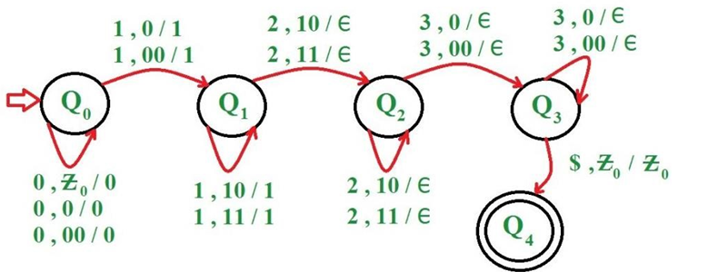
Example
Construct a PDA for language L = {0^{n}1^{m}2^{m}3^{n} | n>=1, m>=1}
Step-1: On receiving 0 push it onto stack. On receiving 1, push it onto stack and goto next state
Step-2: On receiving 1 push it onto stack. On receiving 2, pop 1 from stack and goto next state
Step-3: On receiving 2 pop 1 from stack. If all the 1’s have been popped out of stack and now receive 3 then pop a 0 from stack and goto next state
Step-4: On receiving 3 pop 0 from stack. If input is finished and stack is empty then goto last state and string is accepted

Slide 15
Problems
Design pushdown automata for language {a^{2n}b^{n} | n>=1}
Construct PDA for language L={w/na(w)>nb(w) where w∈(a+b)*}
Design pushdown automata for language {a^{i}b^{j} c^{k}| i=j where i,j,k>=1}
Design pushdown automata for language {a^{i}b^{j} c^{k}| j=k where i,j,k>=1}
Construct PDA for language L={w/na(w)=nb(w) where w∈(a+b)*}

Slide 16
Deterministic Pushdown Automaton (DPDA)
A Deterministic Pushdown Automaton (DPDA) is a type of pushdown automaton (PDA) where, for any given state, input symbol, and stack symbol, there is at most one possible transition, unlike nondeterministic PDAs which can have multiple choices.
Formal Definition:
A DPDA is formally defined as a tuple (Q, Σ, Γ, δ, q₀, Z₀, F), where:Q is a finite set of states.
Σ is a finite set of input symbols.
Γ is a finite set of stack symbols.
δ is the transition function.
q₀ is the initial state.
Z₀ is the initial stack symbol.
F is a set of final states.

Slide 17
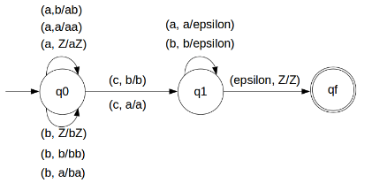
Example
Design DPDA for L={wcw^{R} | w ε (a,b)* }
It is also called odd length palindrome
Solution: L={abcba,abbcbba,........}
Some string will come followed by one 'c', followed by reverse of the string before 'c'.
So we get to know that 'c' will work as an alarm to starting poping STACK.
So we will pop every 'a' with 'a' and every 'b' with 'b'.
For every two a's and b's push them into STACK
When 'c' comes do nothing.
If input symbol is ‘a’ stack’s top most symbol is ‘a’ then do the pop operation
If input symbol is ‘b’ stack’s top most symbol is ‘b’ then do the pop operation
STACK Transiton Function δ :
δ(q0, a, Z) = (q0, aZ)
δ(q0, a, a) = (q0, aa)
δ(q0, b, Z) = (q0, bZ)
δ(q0, b, b) = (q0, bb)
δ(q0, a, b) = (q0, ab)
δ(q0, b, a) = (q0, ba)
// this is decision step
δ(q0, c, a) = (q1, a)
δ(q0, c, b) = (q1, b)
δ(q1, b, b) = (q1, ε)
δ(q1, a, a) = (q1, ε)
δ(q1, ε, Z) = (qf, Z)
Q={q0,q1,qf}, ∑={a,b,c}, Γ={a,b,Z} , q₀ ={q0}, Z0={Z},F={qf}

Slide 18
Previous example explanation
Lets see, how this DPDA is working: We will take one input string: "abbcbba“
Scan string from left to right
First input is 'a' and follow the rule:
on input 'a' and STACK alphabet Z, push the two 'a's into STACK as : (a,Z/aZ) and state will be q0
Second input is 'b' and so follow the rule:
on input 'b' and STACK alphabet 'a', push the 'b' into STACK as : (b,a/ba) and state will be q0
Third input is 'b' and so follow the rule:
on input 'b' and STACK alphabet 'b', push the 'b' into STACK as : (b,b/bb) and state will be q0
Fourth input is 'c' and so follow the rule:
on input 'c' and STACK alphabet 'a' or 'b' and state q0, do nothing as : (c,b/b) and state will be q1
Fifth input is 'b' and so follow the rule:
on input 'b' and STACK alphabet 'b' (state is q1), pop one 'b' from STACK as : (b,b/ε) and state will be q1
Sixth input is 'b' and so follow the rule:
on input 'b' and STACK alphabet 'b' (state is q1), pop one 'b' from STACK as : (b,b/ε) and state will be q1
Seventh input is 'a' and so follow the rule:
on input 'a' and STACK alphabet 'a' and state q1, pop one 'a' from STACK as : (a,a/ε) and state will remain q1
We reached end of the string, so follow the rule:
on input ε and STACK alphabet Z, go to final state(qf) as : (ε, Z/Z)

Slide 19
Non Deterministic Pushdown Automaton (NPDA)
In a non-deterministic pushdown automata (NPDA), this machine has the freedom to explore all possible paths.
It can simultaneously follow multiple paths based on the input and the stack's content.
This means that the machine can accept a string if even one of its possible paths leads to an accepting state.
Defining a Non-Deterministic Pushdown Automata (NPDA):-
A NPDA can be formally described as a 7-tuple (Q, ∑, Γ,δ, q₀, Z0,F) −
Q is the finite number of states
∑ is input alphabet
Γ is stack symbols
δ is the transition function: Q × (∑ ∪ {ε}) × Γ→ 2^{(Q × Γ*)}
q0 − The initial state
Z0 − The initial stack symbol
F − A set of final states

Slide 20
Example
Design NPDA for language L={ww^{R} | w ε (a,b)* }
It is also called even length palindrome
Solution:
If the input symbol is ‘a’ and stack top most symbol is empty we can push ‘a’ on stack. Like wise
If the input symbol is ‘b’ and stack top most symbol is empty we can push ‘b’ on stack.
If the input symbol is ‘a’ and stack top most symbol is ‘b’ we can say that it is not the middle of the string then simply we need to push ‘a’ on stack.
If the input symbol is ‘b’ and stack top most symbol is ‘a’ we can say that it is not the middle of the string then simply we need to push ‘b’ on stack.
If the input symbol is ‘a’ there is a two possibility that i) the centre has come ii) centre not come
Let the input is ‘a’ and the stack top most symbol is ‘a’. Let assume centre is not come there is no problem with this just we need to push ‘a’ on to the stack.
Let the input is ‘a’ and the stack top most symbol is ‘a’. Then we perform pop operation and change the state.
If the input symbol is ‘b’ and stack top most symbol is ‘b’ let assume centre not come just simply we need to push ‘b’ on to the stack.
Let the input is ‘b’ and the stack top most symbol is ‘b’. Then we perform pop operation.

Slide 21
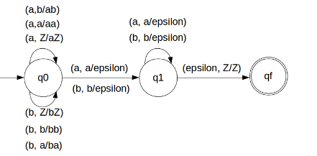
Transition Function
δ(q0, a, Z) = (q0, aZ)
δ(q0, a, a) = (q0, aa)
δ(q0, b, Z) = (q0, bZ)
δ(q0, b, b) = (q0, bb)
δ(q0, a, b) = (q0, ab)
δ(q0, b, a) = (q0, ba)
// this is decision step
δ(q0, a, a) = (q1, ε)
δ(q0, b, b) = (q1, ε)
δ(q1, b, b) = (q1, ε)
δ(q1, a, a) = (q1, ε)
δ(q1, ε, Z) = (qf, Z)
Q={q0,q1,qf}, ∑={a,b,}, Γ={a,b,Z} , q₀ ={q0}, Z0={Z},F={qf}

Slide 22
Lets see, how this DPDA is working: We will take one input string: "abbbba“
Scan string from left to right
First input is 'a' and follow the rule:on input 'a' and STACK alphabet Z, push the two 'a's into STACK as : (a,Z/aZ) and state will be q0
Second input is 'b' and so follow the rule:on input 'b' and STACK alphabet 'a', push the 'b' into STACK as : (b,a/ba) and state will be q0
Third input is 'b' and so follow the rule: on input 'b' and STACK alphabet 'b', push the 'b' into STACK as : (b,b/bb) and state will be q0
Here we will assume that one delimeter comes either that could be 'a' or 'b‘
Forth input is 'b' and so follow the rule: on input 'b' and STACK alphabet 'b' (state is q1), pop one 'b' from STACK as : (b,b/ε) and state will be q1
Fifth input is 'b' and so follow the rule:on input 'b' and STACK alphabet 'b' (state is q1), pop one 'b' from STACK as : (b,b/ε) and state will be q1
Sixth input is 'a' and so follow the rule:on input 'a' and STACK alphabet 'a' and state q1, pop one 'a' from STACK as : (a,a/ε) and state will remain q1
We reached end of the string, so follow the rule:on input ε and STACK alphabet Z, go to final state(qf) as : (ε, Z/Z)

Slide 23
DPDA(Deterministic Pushdown Automata) | NPDA(Non-deterministic Pushdown Automata)
It is less powerful than NPDA. Example: We can only construct DPDA for odd-length palindromes and not for even length palindromes. | It is more powerful than DPDA. Example: NPDA can be constructed for both even-length and odd-length palindromes.
It is possible to convert every DPDA to a corresponding NPDA. | It is not possible to convert every NPDA to a corresponding DPDA.
The language accepted by DPDA is a subset of the language accepted by NPDA. | The language accepted by NPDA is not a subset of the language accepted by DPDA.
The language accepted by DPDA is called DCFL(Deterministic Context-free Language) which is a subset of NCFL(Non-deterministic Context-free Language) accepted by NPDA. | The language accepted by NPDA is called NCFL(Non-deterministic Context-free Language).
There is only one state transition from one state to another state for an input symbol. | There may or may not be more than one state transition from one state to another state for same input symbol.

Slide 24
Turing Machine
A Turing machine is a computational model, like Finite Automata (FA), Pushdown automata (PDA), which works on unrestricted grammar. The Turing machine is the most powerful computation model when compared with FA and PDA.
Formal Definition of Turing machine M can be defined as follows −
M = (Q, ∑, Γ,δ, q₀, Z0,F)
where
Q represents the finite, non-empty set of states.
Γ represents the set of tape alphabets.
∑ represents the non-empty set of input alphabets.
δ is the transition function, whose mapping is given as, δ : Q x Γ → Q x Γ x {Left_shift, Right_shift}.
q0 is the initial state of the machine
B is the blank symbol
F is the set of final states or halt states.

Slide 25
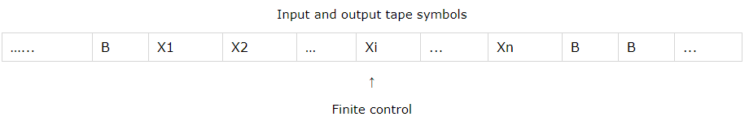
Turing Machine
A single tape Turing machine has a single infinite tape, which is divided into cells.
The tape symbols are present in these cells.
→A finite control is present, which controls the working of Turing machines based on the given input.
→The Finite control has a Read/write head, which points to a cell in tape.
→A Turing machine can move both left and right from one cell to another.
A Turing can have three types of action upon an input.
Print Si, move one square to the left (L) and go to state qj.
Print Si, move one square to the right (R) and go to state qj.
Print Si, do not move (N) and go to state qj.
→The mapping function shows the mapping from states of finite automata and input symbol on the tape to the next states, external symbols and the direction for moving the tape head. This is known as a triple or a program for turing machine.
(q0, a) → (q1, X, R)
That means in q0 state, if we read symbol 'a' then it will go to state q1, replaced a by X and move ahead right(R stands for right).

Slide 26

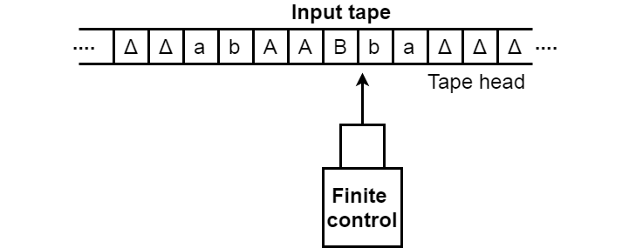
Model
The turning machine can be modelled with the help of the following representation.
1. The input tape is having an infinite number of cells, each cell containing one input symbol and thus the input string can be placed on tape. The empty tape is filled by blank characters.
2. The finite control and the tape head which is responsible for reading the current input symbol. The tape head can move to left to right.
3. A finite set of states through which machine has to undergo.
4. Finite set of symbols called external symbols which are used in building the logic of Turing machine.

Slide 27
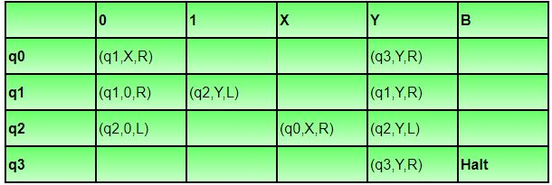
Design of TM Example
Construct a Turing Machine (TM) for the language L = {0ⁿ1ⁿ | n ≥ 1}, which accepts strings of equal 0s followed by equal 1s.
Components:
Q = {q₀, q₁, q₂, q₃} (q₀ is the initial state)
T = {0,1,X,Y,B} (B represents blank, X and Y mark processed symbols)
Σ = {0,1} (input symbols)
F = {q₃} (final state)
Transition Table:
Let us see how this turing machine works for 0011. Initially head points to 0 which is underlined and state is q0 as:
B | 0 | 0 | 1 | 1 | B

Slide 28
The move will be δ(q0, 0) = (q1, X, R). It means, it will go to state q1, replace 0 by X and head will move to right as:
The move will be δ(q1, 0) = (q1, 0, R) which means it will remain in same state and without changing any symbol, it will move to right as:
The move will be δ(q1, 1) = (q2, Y, L) which means it will move to q2 state and changing 1 to Y, it will move to left as:
Working on it in the same way, the machine will reach state q3 and head will point to B as shown:
Using move δ(q3, B) = halt, it will stop and accepted.
B | X | 0 | 1 | 1 | B
B | X | 0 | 1 | 1 | B
B | X | 0 | Y | 1 | B
B | X | X | Y | Y | B

Slide 29
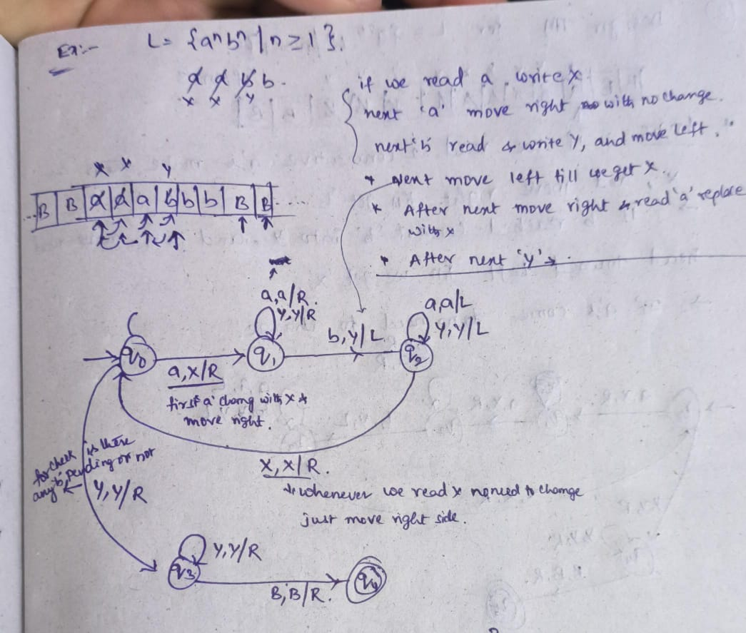
Example
Transition Functions:
δ(q0, a) = (q1, X, R)
δ(q1, a) = (q1, a, R)
δ(q1, Y) = (q1, Y, R)
δ(q1, b) = (q1, Y, L)
δ(q2, a) = (q2, a , L)
δ(q2, Y) = (q2, Y , L)
δ(q2, X) = (q0, X , R)
δ(q0, Y) = (q3, Y , R)
δ(q3, Y) = (q3, Y , R)
δ(q3, B) = (q4, B , R/L) Halt
State | a | b | X | Y | B
q0 | (q1, X, R) |  |  | (q3, Y , R)
q1 | (q1, a, R) | (q1, Y, L) | (q1, Y, R)
q2 | (q2, a , L) |  | (q0, X , R)
q3 |  |  |  | (q3, Y , R) | = (q4, B , R/L)
q4 |  |  |  |  | Halt

Slide 30
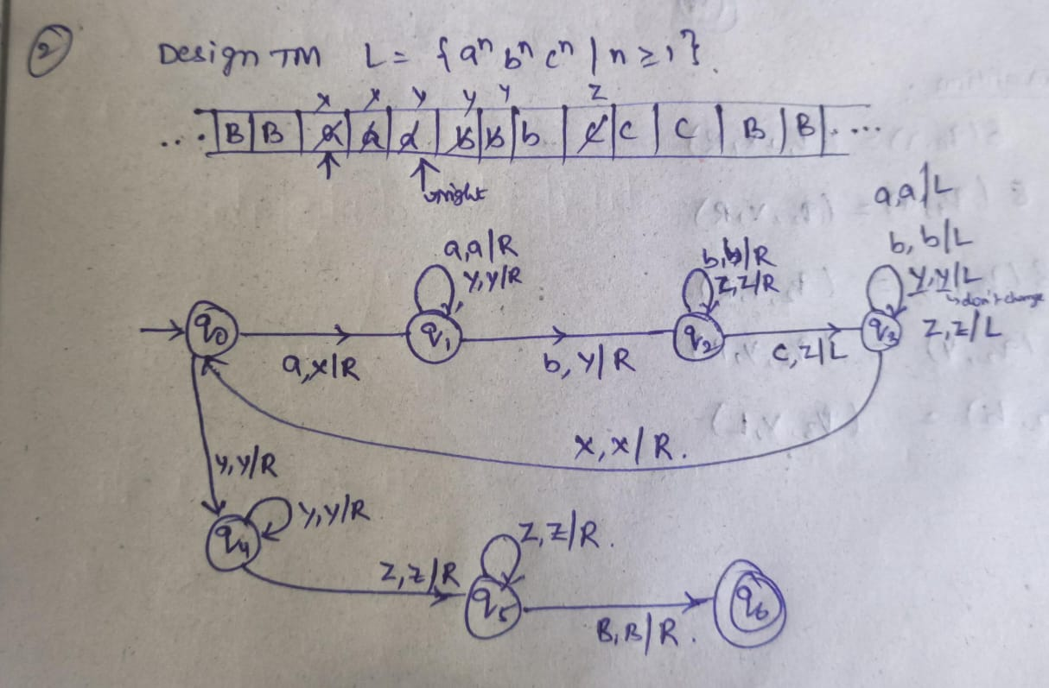
Transition Functions:
δ(q0, a) = (q1, X, R)
δ(q1, a) = (q1, a, R)
δ(q1, Y) = (q1, Y, R)
δ(q1, b) = (q2, Y, R)
δ(q2, b) = (q2, b , R)
δ(q2, Z) = (q2, Z , R)
δ(q2, c) = (q3, Z , L)
δ(q2, c) = (q3, Z , L)
δ(q3, a) = (q3, a , L)
δ(q3, b) = (q3, b , L)
δ(q3, Y) = (q3, Y , L)
δ(q3, Z) = (q3, Z , L)
δ(q3, X) = (q0, X , R)
δ(q0, Y) = (q4, Y , R)
δ(q4, Y) = (q4, Y , R)
δ(q4, Z) = (q5, Z , R)
δ(q5, Z) = (q5, Z , R)
δ(q5, B) = (q6, B , R/L) Halt
State | a | b | c | X | Y | Z | B
q0 | (q1, X, R) |  |  |  | (q4, Y , R)
q1 | (q1, a, R) | (q2, Y, R)
q2 |  | (q2, b , R) | (q3, Z , L) |  |  | (q2, Z , R)
q3 | (q3, a , L) | (q3, b , L) |  | (q0, X , R) | (q3, Y , L) | (q3, Z , L)
q4 |  |  |  |  | (q4, Y , R) | (q5, Z , R)
q5 |  |  |  |  |  | (q5, Z , R) | (q6, B , R/L)
q6 |  |  |  |  |  |  | Halt

Slide 31
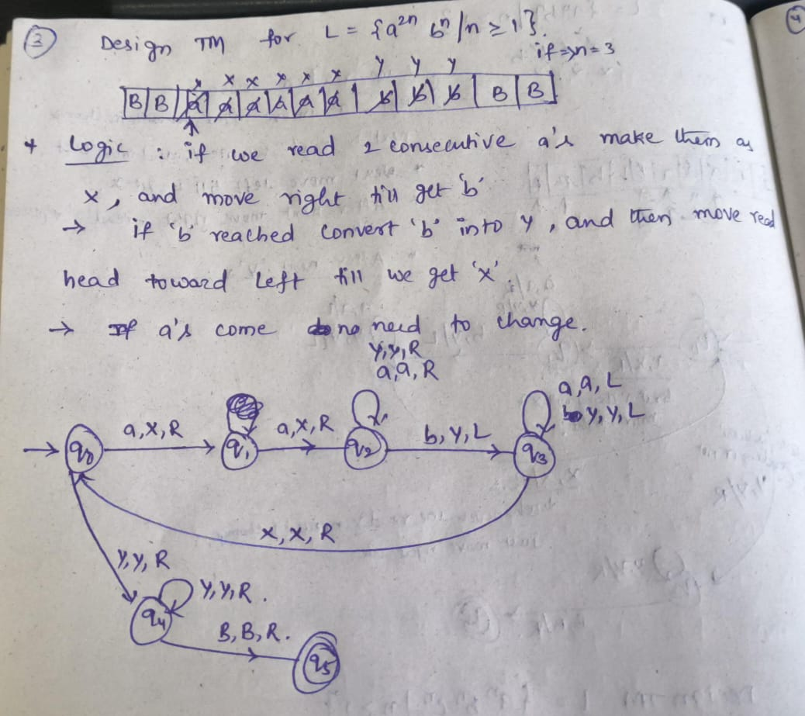
Transition Functions:
δ(q0, a) = (q1, X, R)
δ(q1, a) = (q2, X, R)
δ(q2, a) = (q2, a, R)
δ(q2, Y) = (q2, Y, R)
δ(q2, b) = (q3, Y, L)
δ(q3, a) = (q3, a , L)
δ(q3, Y) = (q3, Y , L)
δ(q3, X) = (q0, X , R)
δ(q0, Y) = (q4, Y , R)
δ(q4, Y) = (q4, Y , R)
δ(q4, B) = (q5, B , R/L) Halt
Q={q0,q1,q2,q3,q4,q5}, ∑={a,b,}, Γ={a,b,X,Y,B} ,
q₀ ={q0},F={q5}

Slide 32
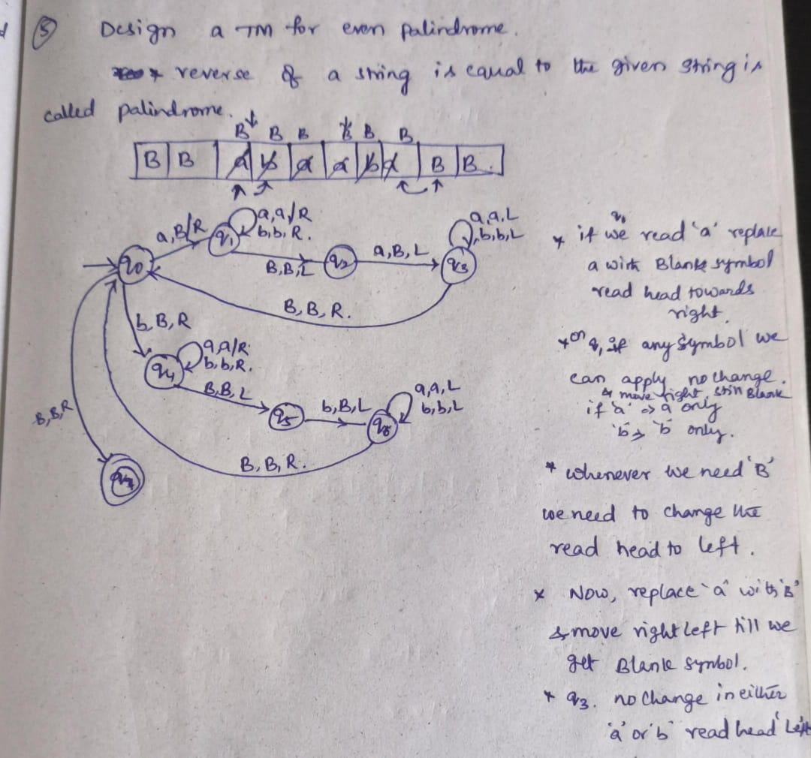
Transition Functions:
δ(q0, a) = (q1, B, R)
δ(q1, a) = (q1, a, R)
δ(q1, b) = (q1, b, R)
δ(q1, B) = (q2, B, L)
δ(q2, a) = (q3, B, L)
δ(q3, a) = (q3, a, L)
δ(q3, b) = (q3, b, L)
δ(q3, B) = (q0, B, R)
δ(q0, b) = (q4, B, R)
δ(q4, a) = (q4, a, R)
δ(q4, b) = (q4, b, R)
δ(q4, B) = (q5, B, L)
δ(q5, b) = (q6, B, L)
δ(q6, a) = (q6, a, L)
δ(q6, b) = (q6, b, L)
δ(q6, B) = (q0, B, R)
δ(q0, B) = (q7, B , R/L) Halt

Slide 33
Recursive languages
A language ‘L’ is said to be recursive language if there exist a turing machine that accepts every string w∈L and halts while rejects every string w∈L halts
Recursive language is the subset of recursive enumerable language.
Complement of a recursive language is recursive language.
w∈L
Turing machine accepts w and halts
Turing machine rejects w and halts.
w∈L
L
L^{c}
TM
w∈L
w∈L
Yes
No
Halt
Halt

Slide 34
Recursively Enumerable languages
A language ‘L’ is said to be recursive enumerable if there exist a turing machine that accepts string w∈L and for string w∈L , turing machine either may halt in non final state or may not goes into infinite loop.
Recursive enumerable language is the superset of recursive language.
Complement of recursive enumerable is not recursive enumerable.
w∈L
Turing machine accepts w
Turing machine may halt on non final state
w∈L
Turing machine may goes into infinite loop
L^{c}
L
TM
w∈L
Yes
No
∞
w∈L

Slide 35
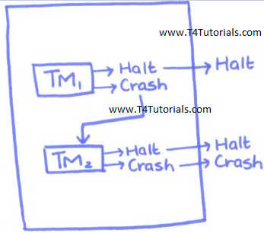
Properties of Recursively enumerable languages
Union ,Intersection, Complement
Union of RE languages
Let’s revise union of sets;
Set 1={a, b, c}
Set 2={b, c, d}
Set 1 Union Set 2 = {a, b, c, d}
Now let’s understand the same concept in Turing Machine;
Suppose a system has 2 Turing Machines, TM1, and TM2.
If TM1 halts then all the system halts.
If TM1 crash then system checks that TM2 is ready to halt or not? If TM2 halts then system halts because this is union and the union means that
If TM1 halts then system halts
If TM1 does not halt, and TM2 halts then system halts
If TM1 and TM2 or TM_{n} halts then system halts
Figure: Union of RE languages

Slide 36
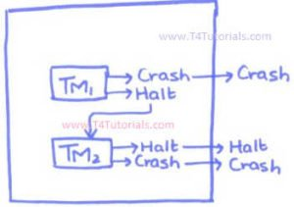
The intersection of RE languages
Let’s revise the intersection of sets;
Set 1={a, b, c}
Set 2={b, c, d}
Set 1 Intersection Set 2 = {b, c}
Now let’s understand the same concept in Turing Machine;
Suppose a system has 2 Turing Machines, TM1, and TM2.
If TM1 crash then all the system crash.
If TM1 halts then system checks that TM2 is ready to halt or not? After this, If TM2 halts then system halts because this is intersection and the intersection means that
If TM1 crash then system crash
If TM1 halts then check TM2 or TM_{n}, and if TM2 is also halted, the system halts.
If TM1 and TM2 or TM_{n} crash then the system crash
Figure: Intersection of Recursive Enumerable languages

Slide 37
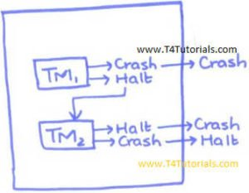
The complement of RE languages
Suppose a system has 2 Turing Machines, TM1, and TM2.
If TM1 crash then all the system crash.
If TM1 halts then system check TM2 or TM_{n}. If TM1 halts and TM2 also halts then system crash.
If TM1 halts then system check TM2 or TM_{n}. If TM1 halts and TM2 crash then system halts.
Figure: Complement of recursively enumerable languages

